Slide 1





Front – End
@centricexpress
25 March 2023

Slide 2
Who are we?
Andreea
Sologon
Carla Moroșan
Maria
Bulboacă
Claudiu
Bujeniță

Slide 3
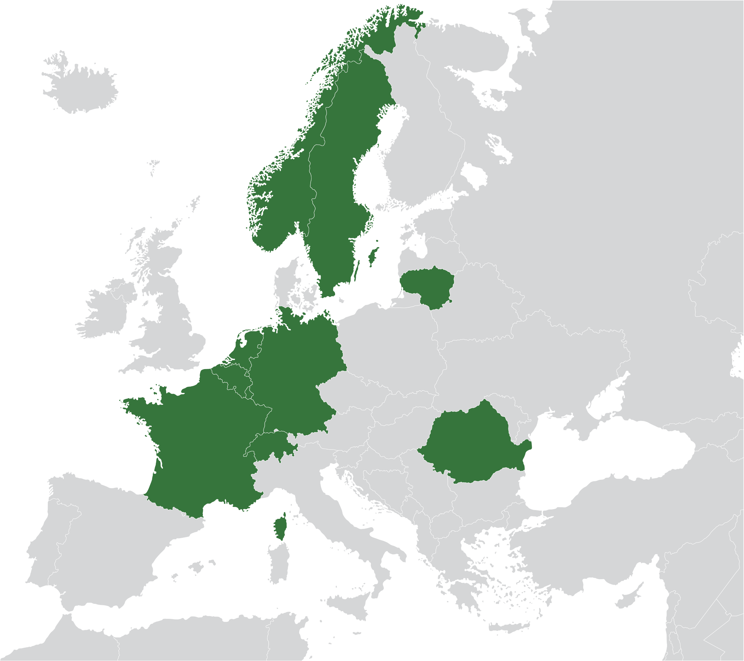




Centric HQ
Who Are We?
Centric is an organization of 4300 IT professionals and with sales of 482 million euros in 2019.
Centric IT Solutions Lithuania
Centric operates in Belgium, Germany, France, Lithuania, Luxembourg, the Netherlands, Norway, Romania, Sweden and Switzerland.
In the Netherlands alone, Centric serves over 3500 clients with more than 200 software solutions.
Software and Cloud developement Centers
Centric IT Solutions Romania
3
Notes:
Companie de IT, multi nationala, cu vechime apreciabila, fondata in Olanda cam in 1992.
In present Centric are sedii in 10 tari din Europa
Autentici prin faptul ca Centric este o companie de produs (propiile produse). Avem si f putin acoperita zona de outsorcing.
Peste 3500 de client, din varii domenii cum ar fi hr & payroll, sectorul public olandez, retail.

Slide 4


OUR OFFICE IN IASI
PALAS, UBC4
4 FLOORS
350+ EMPLOYEES
.NET
PRODUCT DEVELOPMENT & OUSOURCING

Slide 5
Technology Stack
Frontend
Backend
Databases
Mobile Dev.
Cloud
Techniques
Angular
VueJs
React
ExtJS
Sencha
React
Native JavaScript
Single Page Application
Progressive Web Apps
.NET
NodeJS
Serverless
Spring Spring Boot
Azure Functions
Lambda Functions
SQL Server
Oracle
Postgres
MongoDB
RavenDB
CouchDB
DynamoDB
CosmosDB
Casandra
MySQL
Xamarin
Java for Android
Swi
React Native
Azure Google AWS
BDD
Creating POC DDD
Event
Storming
Knowledge Sharing
TDD
And many more..
Notes:
Tehnologiile cu care lucreaza Centric sunt preponderant Microsoft (.net)
Incercam sa tinem pasul pe cat posibil cu ultimele tehnologii pe proiectele noastre.
Echipele lucreaza in metodologia scrum si isi organizeaza munca pe sprinturi, pe niste detalii bine definite
De asemenea avem roluri bine definite pentru fiecare tip de activitate, pentru a fi cat mai eficienti

Slide 6


How we LEARN
Notes:
Punem accent pe crestere, este o valoare a noastra.
Avem mai multe programe prin care facem asta.

Slide 7



Student programs

Slide 8
What’s next – Internship Recruitment Process
CV’s Screening
HR Discussion
Technical Test
Technical Interview
Discussion with the Team Leader
Final Feedback

Slide 9


Who are you?

Slide 10

Agenda for today
HTML
CSS
Basic JavaScript
Introduction to Angular
Create and explain project structure
Present routing
What is a component?
Data binding

Slide 11
Agenda for today
Lifecycle hooks
Working with forms
Validate forms
Angular Services
HttpClient
Working with RxJs
Angular Material
Q & A / Feedback

Slide 12

Hypertext Markup Language (HTML)
The language for describing the structure of Web pages;
It can be assisted by technologies such as Cascading Style Sheets (CSS) and scripting languages such as JavaScript;
NOT a programming language;

Slide 13
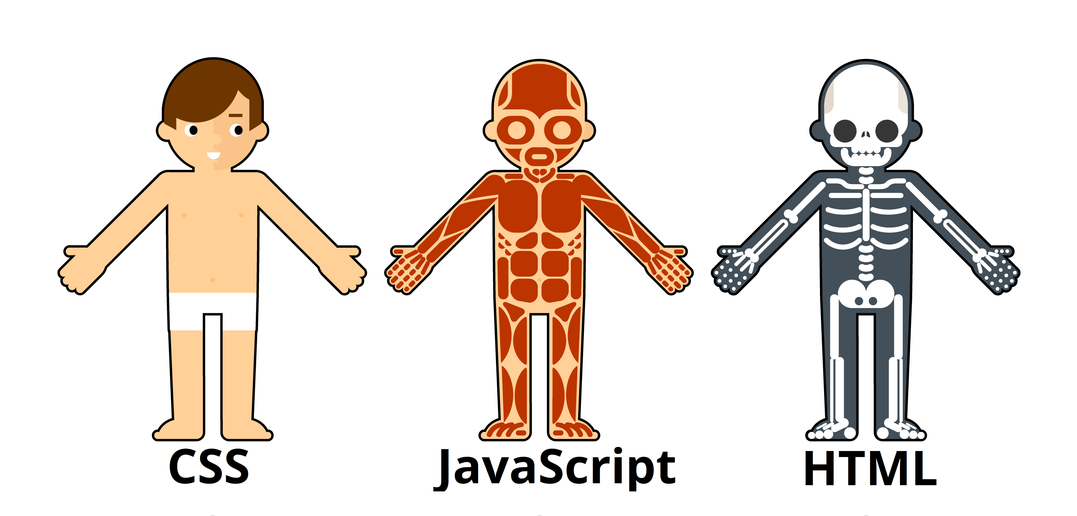
How webpages working

Slide 14
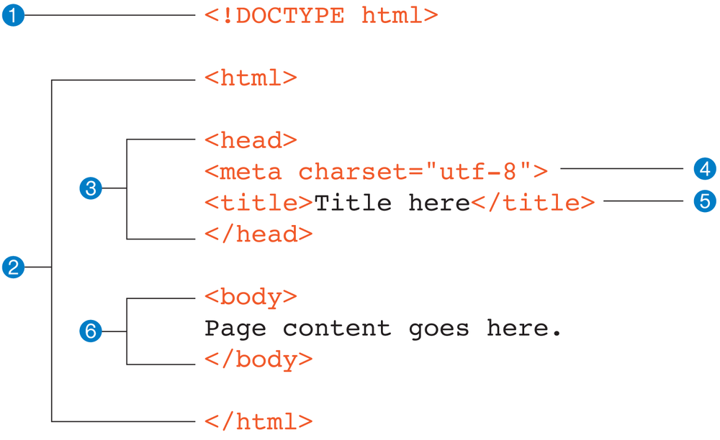
Document structure
Notes:
1 - Isn’t an element at all. Identifies this document as an HTML5 document lets modern browsers know they should interpret the document as written according to the HTML5 specification
2 - html este elementul radacina . contains all the elements in the document. Can’t be contained in another element
3 - The head element contains descriptive information about the document itself, such as its title, the style sheet(s) it uses, scripts, and other types of “meta” information
4 - A meta element can be used to provide all sorts of information, but in this case, it specifies the character encoding (the standardized collection of letters, numbers, and symbols) used in the document.
5 - According to the HTML specification, every document must contain a descriptive title
6 - the body element contains everything that we want to show up in the browser window
Document Object Model

Slide 15
DOM manipulation
Get element by:
Id - <h1 id="title">… #title
Class - <h1 class="foo">… .foo
Tag name - <h1>… h1
Removing nodes;
Adding nodes;

Slide 16
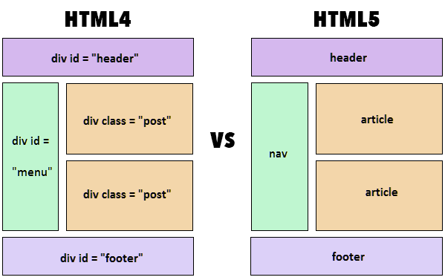
Semantic elements

Slide 17
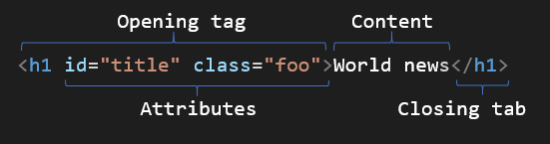
Element Anatomy

Slide 18
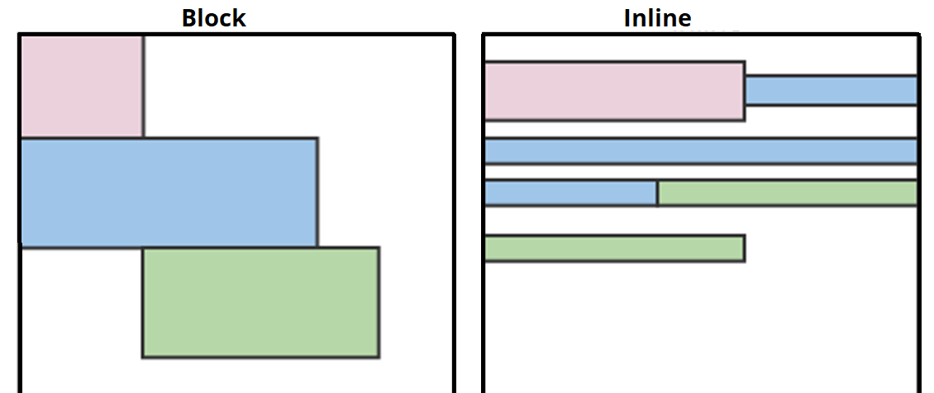
Elements display types
Notes:
Block elements always appear on a new line
p, h1-h6, ul, div, fieldset, form, hr, table…
Inline elements do not start on new line
button, input, label, select, textarea, img, a, span, strong…

Slide 19

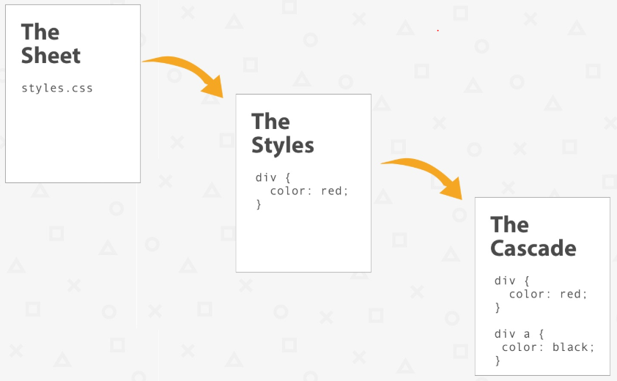
Cascading Style Sheets (CSS)
Style sheets for describing the presentation of Web pages, including colors, layout and fonts;
Allows to adapt the presentation to different types of devices, such as large screens, small screens, etc;

Slide 20
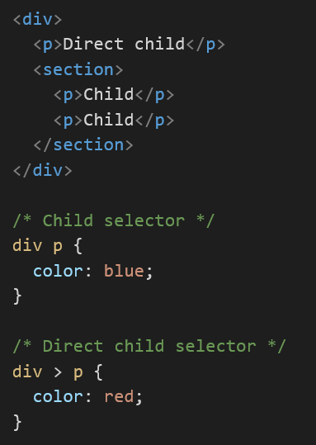
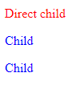
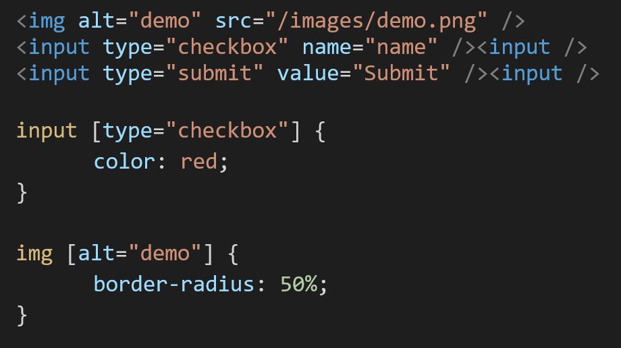
CSS selectors
Child selectors:
Attribute selectors:

Slide 21
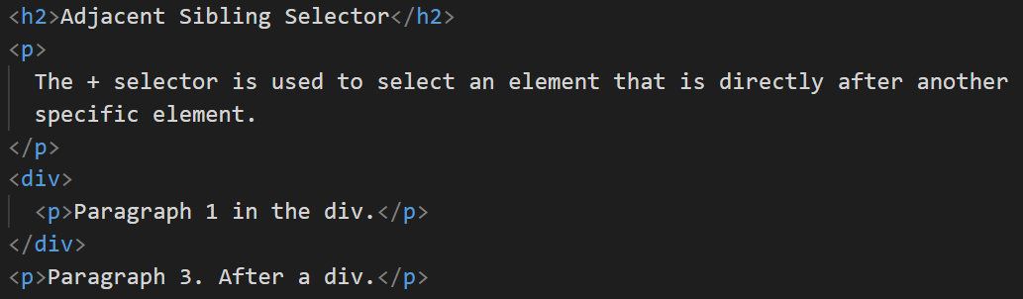
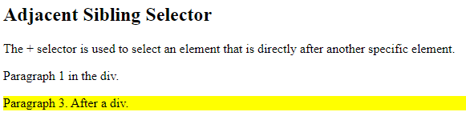
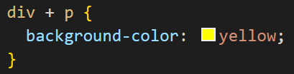
CSS selectors

Slide 22
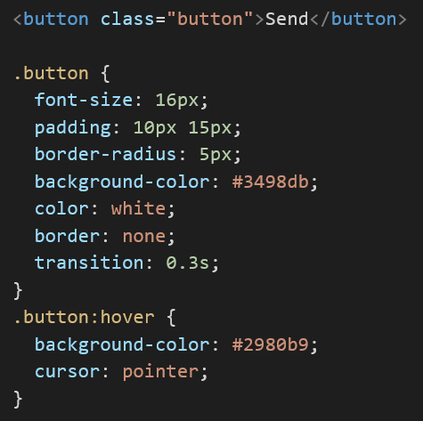
CSS Pseudo-classes
Are used to define a special state of an element;
Style an element when a user mouses over it, visited or unvisited, or when it gets focus etc;

Slide 23
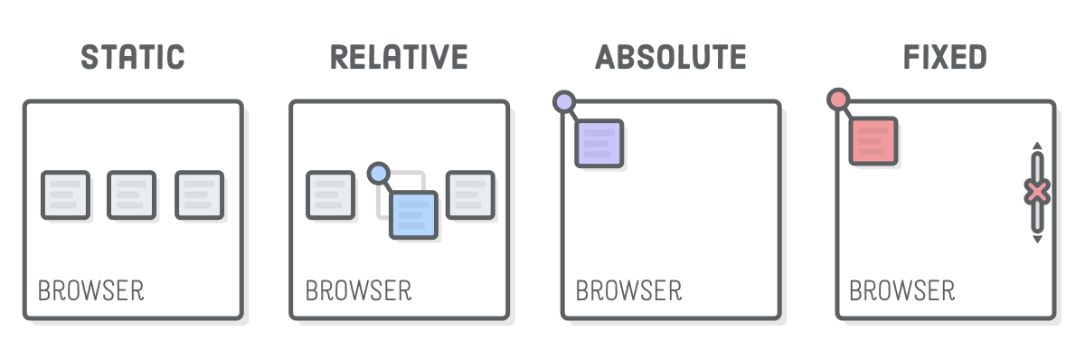
Positioning
Notes:
Static positioned elements are not affected by the top, bottom, left, and right properties.
Relative is positioned relative to its normal position.
Absolute is positioned relative to the nearest positioned ancestor
Fixed is positioned relative to the viewport, which means it always stays in the same place even if the page is scrolled’
Sticky is positioned based on the user's scroll position. toggles between relative and fixed

Slide 24
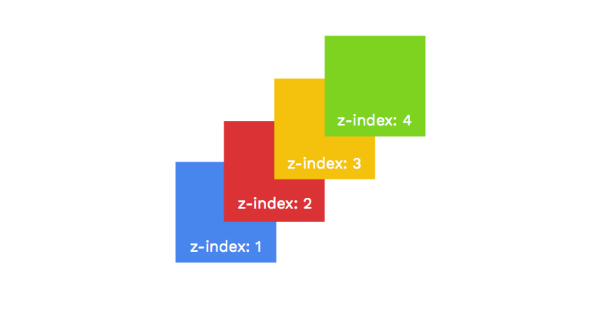
Z-index
Notes:
We could use negative values for z-index
The z-index property specifies the stack order of an element.
An element with greater stack order is always in front of an element with a lower stack order.

Slide 25
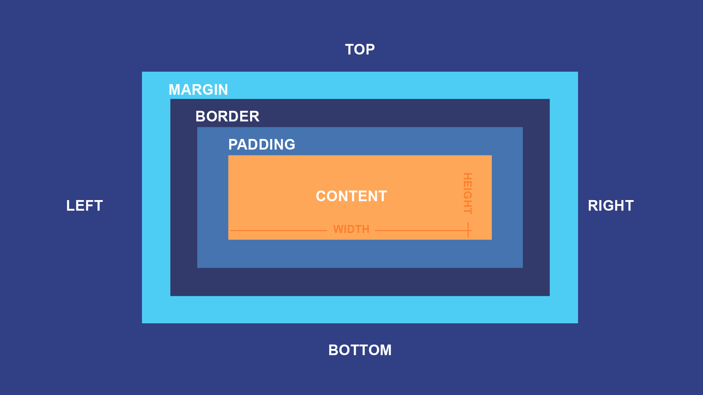
Box model example
div { width: 320px; padding: 10px; border: 5px solid gray; margin: 0; }

Slide 26

Exercise

Slide 27
Flexbox
A new layout mode in CSS3
Optimized for web and mobile devices
Helps with aligning and distributing space

Slide 28
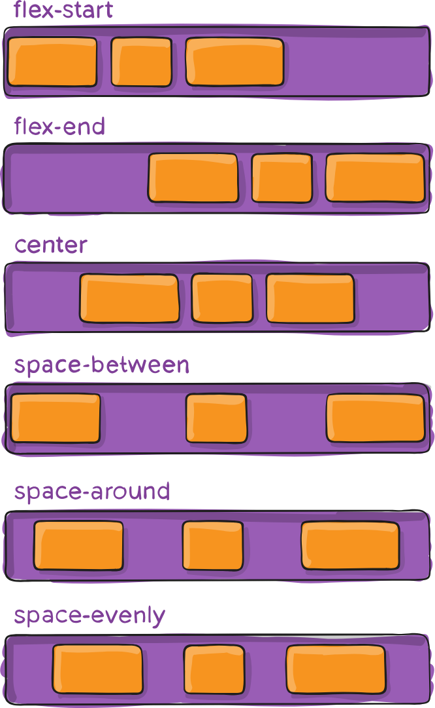
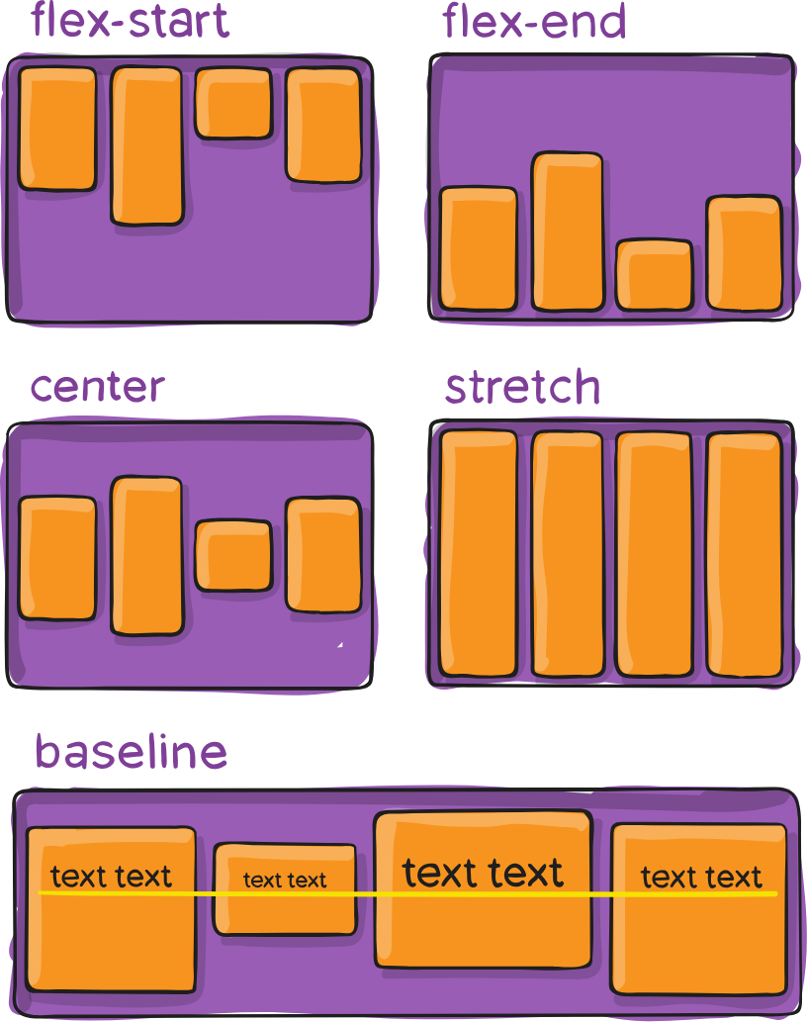
Flexbox align-items & justify-content
Notes:
https://css-tricks.com/snippets/css/a-guide-to-flexbox/
Align-items: align items on secondary axis
Justify-content: align items on main axis

Slide 29
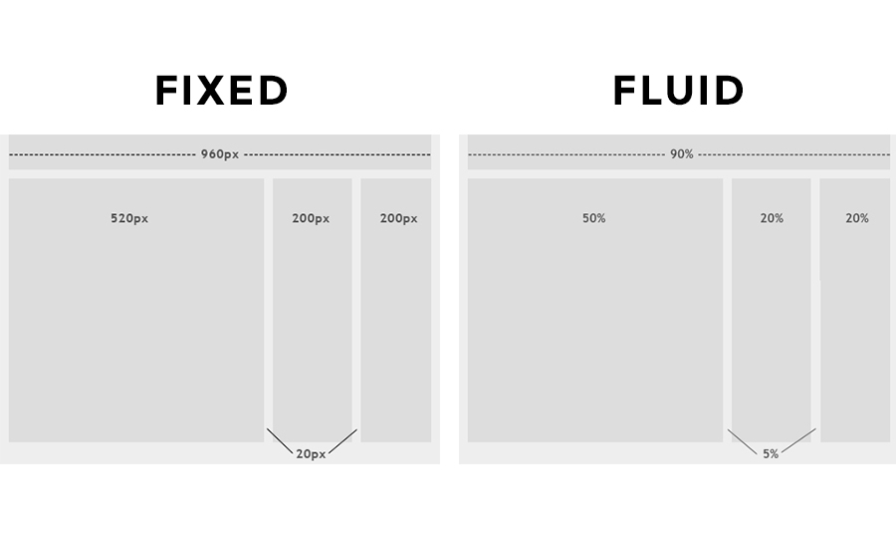
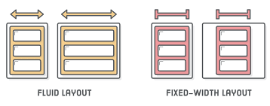
Fluid UI
Fluid elements are elements that stretch and shrink to fill the width of the screen;
It use relative sizes (width: 100%);
Fluid elements are elements that stretch and shrink to fill the width of the screen
Use relative sizes (width: 100%)

Slide 30
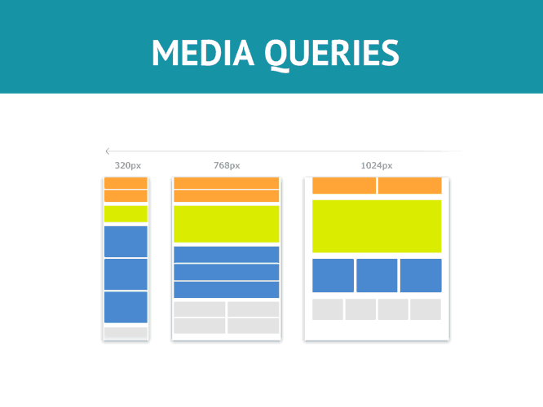
Responsiveness
Styles are applied only on specific cases
Instead of creating separate websites for desktop/mobile, we can only change the styles

Slide 31
Media queries syntax
@media not|only mediatype and (expressions) { CSS-Code; }
CSS3 Media Types:
all | Used for all media type devices
print | Used for printers
screen | Used for computer screens, tablets, smart-phones etc.
speech | Used for screen readers that "reads" the page out loud

Slide 32
CSS preprocessor
CSS Preprocessors compile the code which is written using a special compiler. They then use that to create a CSS file, which can then be referenced by the main HTML document;
Types:
Sass;
Less;

Slide 33
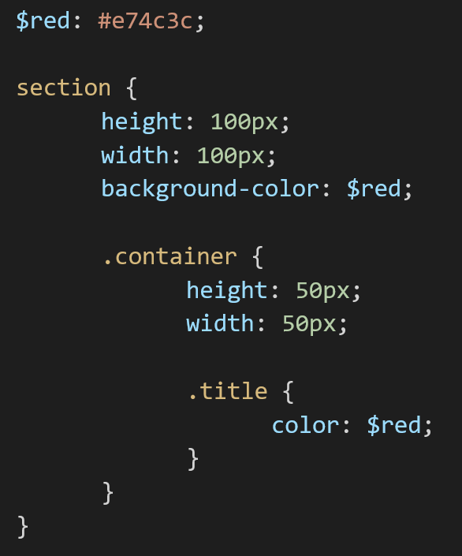
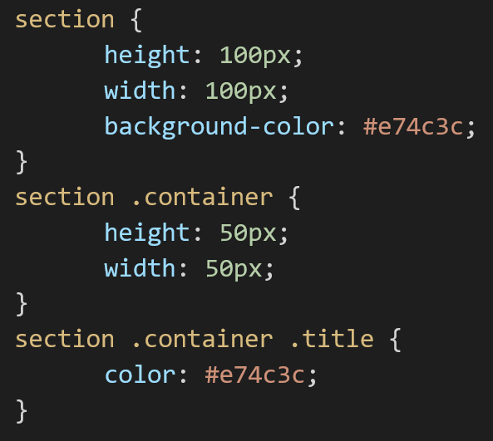
SASS (Syntactically Awesome Style Sheets)

Slide 34

Media queries - example
Centric express (codepen.io)

Slide 35

Break

Slide 36

JavaScript
Was initially created to “make web pages alive”;
Father of all new frameworks;
Is a scripting language that enables you to create dynamically updating content, control multimedia, animate images, and pretty much everything else.

Slide 37
JavaScript (ECMAScript)
Today, JavaScript can execute not only in the browser, but also on the server, or on any device that has a special program called the JavaScript engine;
The browsers have an embedded engine;

Slide 38
Why we love JavaScript
full integration with HTML/CSS;
simple things are done simply;
support by all major browsers and enabled by default;

Slide 39
What can in-browser JavaScript do?
Add new HTML to the page, change the existing content, modify styles;
React to user actions, run on mouse clicks, pointer movements, key presses;
Send requests over the network to remote servers, download and upload files;
Get and set cookies, ask questions to the visitor, show messages;
Remember the data on the client-side (“local storage”);

Slide 40
JavaScript data types and data structures
JavaScript is a loosely typed and dynamic language. Variables in JavaScript are not directly associated with any value type, and any variable can be assigned (and re-assigned) values of all type;
The latest ECMAScript standard defines nine types;

Slide 41
Data types
Data types | Description | Examples
String | represents textual data | 'hello', "hello world!"
Number | an integer or a floating-point number | 3, 3.234, 3e-2 etc.
BigInt | an integer with arbitrary precision | 900719925124740999n, 1n etc.
Boolean | Any of two values: true or false | true and false
undefined | a data type whose variable is not initialized | let a;
Symbol | data type whose instances are unique and immutable | let value = Symbol('hello');

Slide 42
Structural types
Data types | Description | Examples
Object | Special non-data but Structural type for any constructed object instance also used as data structure | let a = new Object; let b = new Array; let c = { };
Function | This is merely a special shorthand for Functions, though every Function constructor is derived from Object constructor | let d = function() { … };
Data types | Description | Examples
null | Special primitive type having additional usage for its value: if object is not inherited, then null is shown | let a = null;

Slide 43
JavaScript scopes
Scope determines the accessibility (visibility) of variables. It has:
Block scope
Function scope
Global scope
Before ES6 (2015), JavaScript had only Global Scope and Function Scope;

Slide 44
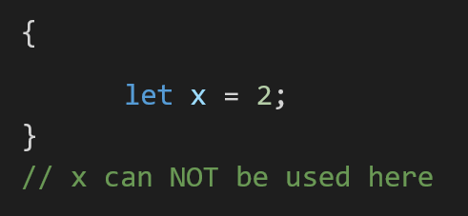
Block scope
ES6 introduced two important new JavaScript keywords: let and const;
Variables declared inside a { } block cannot be accessed from outside the block;
Notes:
Example: variable declared in an if or loop statement

Slide 45
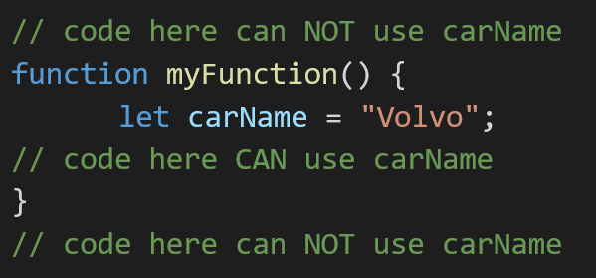
Function scope
JavaScript has function scope: Each function creates a new scope;
Variables defined inside a function are not accessible (visible) from outside the function;

Slide 46
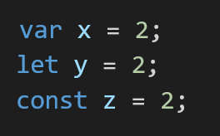
Global scope
Variables declared Globally (outside any function) have Global Scope;
Global variables can be accessed from anywhere in a JavaScript program;

Slide 47
var, let and const
Let and const:
are introduced with ECS6
are block scope;
cannot be instanced again and gets an error when it is tried;
cannot be used before are declared;
Var:
from the beginning of JavaScript
is function scope;
can be instanced again without notice and produce confusion;
can be used before declared and have an undefined value
Notes:
Js used to have one keyword “var” and was used for all
Let and const are block scopes, while var is function scope;
Var can be reassigned multiple times by redeclaring;
Biggest problem with var, can be redeclared without know and accidently have bugs;
Var variables can be called before being declared and have undefined value -> no error, but with let cannot be done this
Let vs const -> cannot change value with const

Slide 48

Exercise

Slide 49
Nice to do exercises
CSS Diner - Where we feast on CSS Selectors! (flukeout.github.io)
Flexbox Froggy - A game for learning CSS flexbox

Slide 50
Break

Slide 51

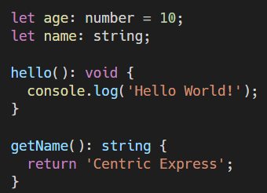
TypeScript
it is a superset for JavaScript;
is concentrated on adding “strict data typing” over JavaScript, to simplify the development and support of complex systems;
makes code easier to read and understand;

Slide 52
Modules
TypeScript provides modules and namespaces in order to prevent the default global scope of the code and to organize and maintain a large code base;
Modules are a way to create a local scope in the file. So, all variables, classes, functions, etc. that are declared in a module are not accessible outside the module. A module can be created using the keyword export and can be used in another module using the keyword import;

Slide 53
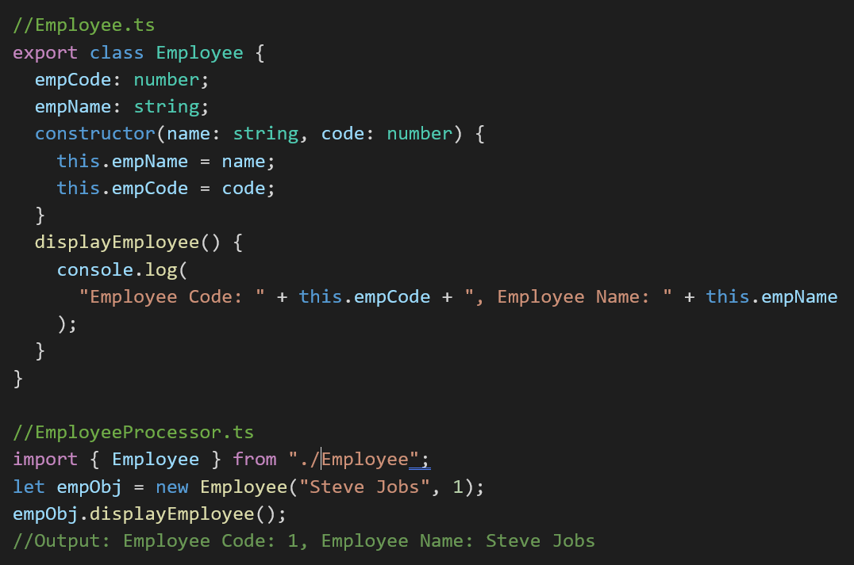
Usage of modules

Slide 54
SPA – single page application
A single-page application is an app that works inside a browser and does not require page reloading during use. You are using this type of applications every day. Example: Gmail, Google Maps, Facebook or GitHub;
SPAs are all about serving an outstanding UX by trying to imitate a “natural” environment in the browser — no page reloads, no extra wait time. It is just one web page that you visit which then loads all other content using JavaScript — which they heavily depend on;

Slide 55

Angular
Angular is an open-source, JavaScript framework written in TypeScript. Google maintains it, and its primary purpose is to develop single-page applications;
As a framework, Angular has clear advantages while also providing a standard structure for developers to work with. It enables users to create large applications in a maintainable manner;

Slide 56
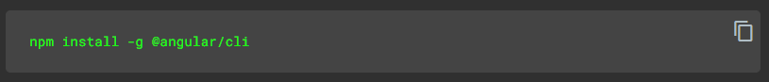
Install Angular CLI
Angular CLI creates projects, generates application and library code, and performs a variety of ongoing development tasks such as testing, bundling, and deployment;
*CLI – Command Line Interface

Slide 57
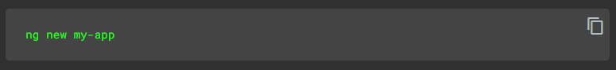
Create a workspace and initial application
The ng new command prompts you for information about features to include in the initial app. Accept the defaults by pressing the Enter or Return key.

Slide 58
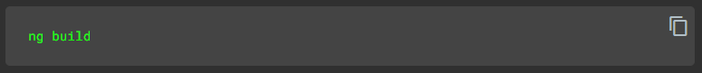
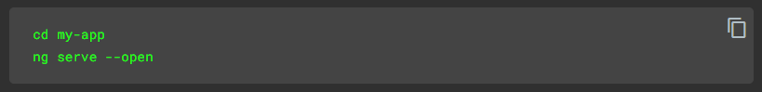
Build and run the application
To build your application for production, use the build command. By default, this command uses the production build configuration
Angular CLI includes a server, so that you can build and serve your app locally

Slide 59
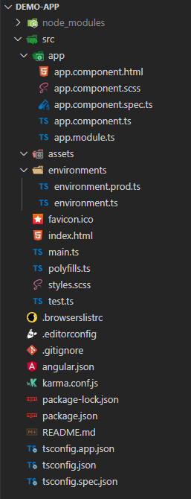
Angular project structure
Files | Purpose
app/ | Component files
assets/ | Images and other assets files
environments/ | Build configuration options for target environments
favicon.ico | Icon use for application in tab
index.html | Main html page
main.ts | Entry point of the application
polyfills.ts | Polyfill scripts for browsers
styles.scss | Lists css file that supply project styles
test.ts | Main point for unit tests
Notes:
Other are used for application-specific configuration

Slide 60
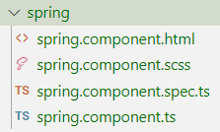
Angular components
Components are the main building block for Angular applications
CLI command: ng generate component <component-name>
This command creates the following:
A folder named after the component
A component file <component-name>.component.ts
A template file <component-name>.component.html
A CSS file <component-name>.component.css
A testing specification file <component-name>.component.spec.ts

Slide 61
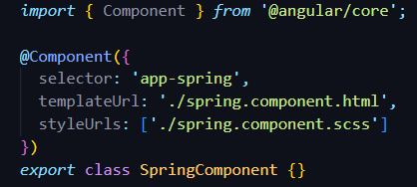
Angular components
Every component requires a CSS selector. A selector instructs Angular to instantiate this component wherever it finds the corresponding tag in template HTML;

Slide 62
Angular routing
In a single-page app, you change what the user sees by showing or hiding portions of the display that correspond to components, rather than going out to the server to get a new page
The Router enables navigation by interpreting a browser URL as an instruction to change the view

Slide 63
Types of routing
Eager loading
Feature modules under Eager Loading would be loaded before the application starts. This is the default module-loading strategy;
Lazy loading
Feature modules under Lazy Loading would be loaded on demand after the application starts. It helps to start application faster;

Slide 64
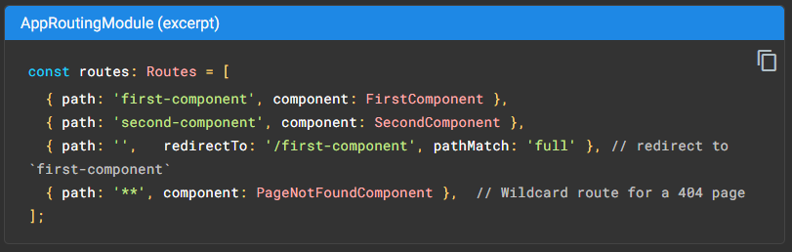
Example of routing

Slide 65
Structural directives
Structural Directives are directives which change the structure of the DOM by adding or removing elements.
There are three built-in structural directives:
ngIf
ngFor
ngSwitch

Slide 66
Data binding
Property binding
Event binding
Two-way binding

Slide 67
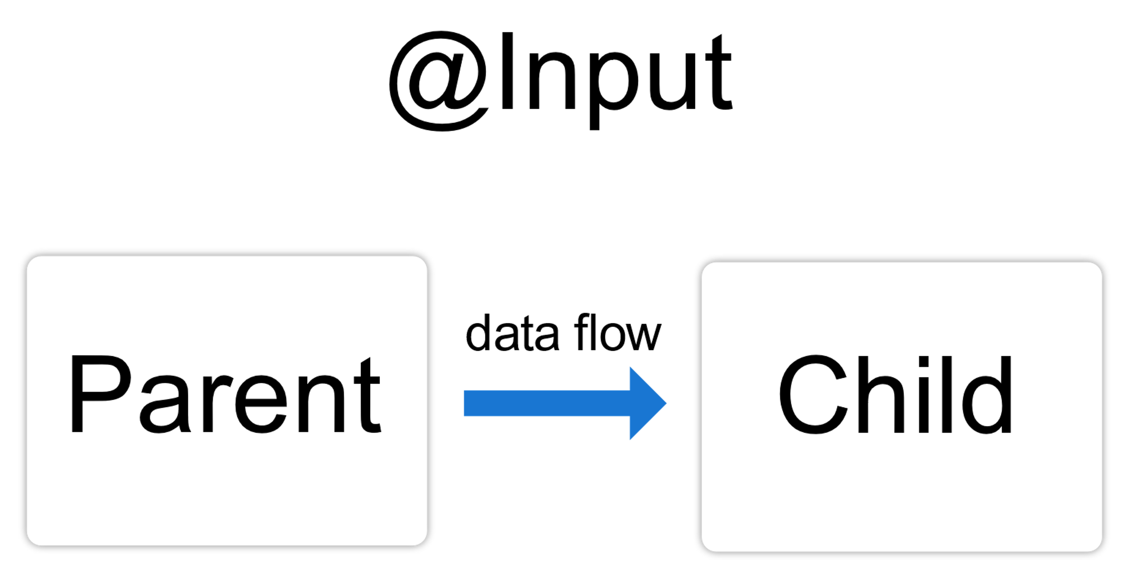
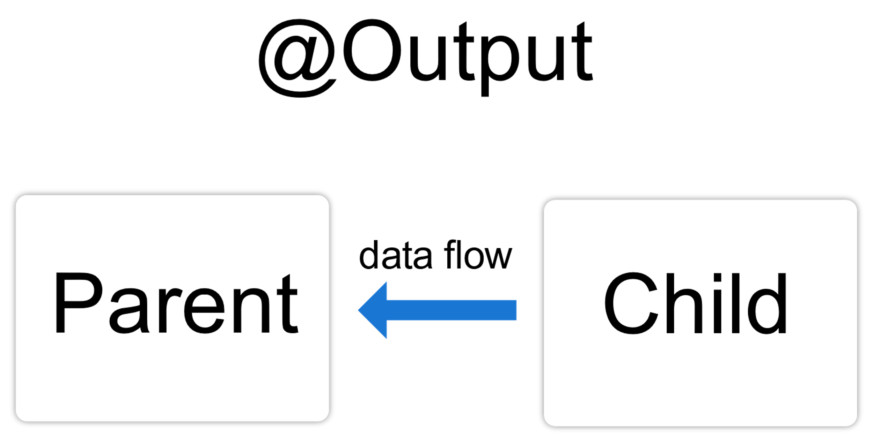
Bind values between components

Slide 68
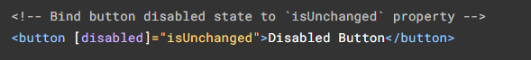
Property binding
Moves a value in one direction, from a component's property into a target element property.
Enclose it in square brackets, []
Example:
Toggling button disabled functionality

Slide 69
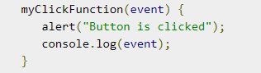
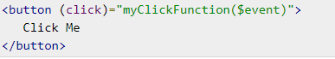
Event binding
Allows you to listen for and respond to user actions such as keystrokes, mouse movements, clicks, and touches
Enclose it in round brackets, ()

Slide 70
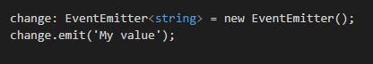
Custom events
You can create custom events with EventEmitter class
Methods:
emit() - emits an event containing a given value

Slide 71
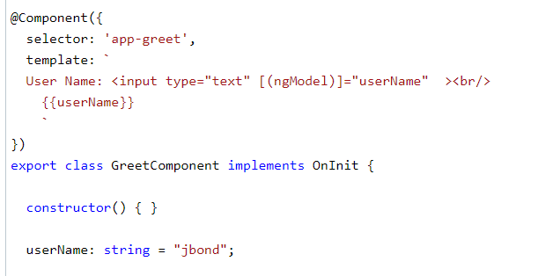
Two-way binding
Combines property binding with event binding
[()] = [] + () where [] binds attribute, and () binds an event.
Example:

Slide 72
Break

Slide 73

Lifecycle hooks

Slide 74
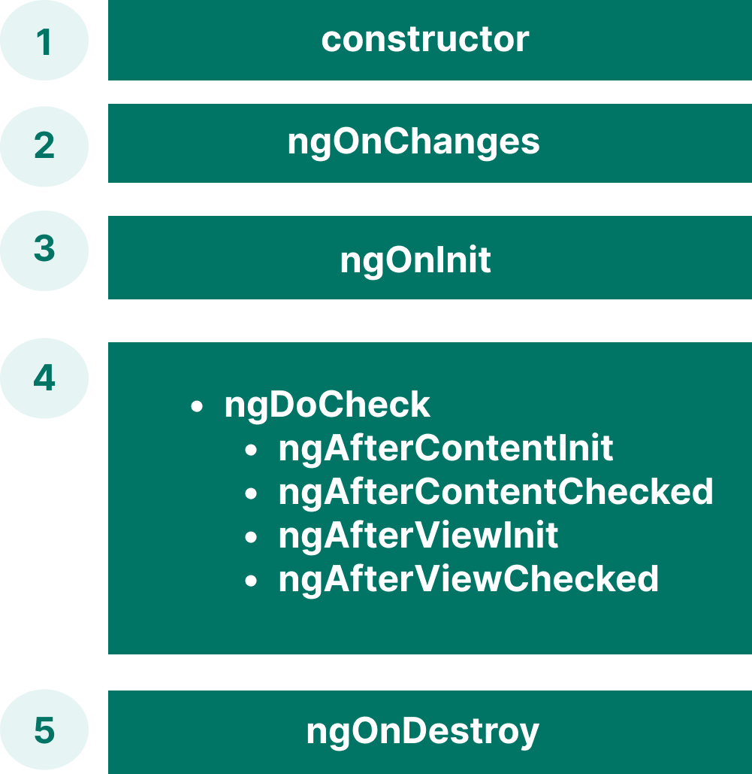
Lifecycle hooks
The hooks give you the opportunity to act on a component or directive instance at the appropriate moment, as Angular creates, updates, or destroys that instance.

Slide 75
Component hooks
constructor
when Angular creates a component or directive by calling new on the class
ngOnChanges
every time there is a change in one of the input properties of the component
ngOnInit
when given component has been initialized
called once after the first ngOnChanges()
ngDoCheck
when the change detector of the given component is invoked
is invoked even if there is no change in any of the properties

Slide 76
Component hooks
AfterContent hooks concern ContentChildren, the child components that Angular projected into the component.
ngAfterContentInit
is called after the Component’s projected content has been fully initialized
this hook is also raised even is no content to project
external content injected from the parent component via Content Projection
ng-content element: placeholder for the content from the parent
called only during the first detection change

Slide 77
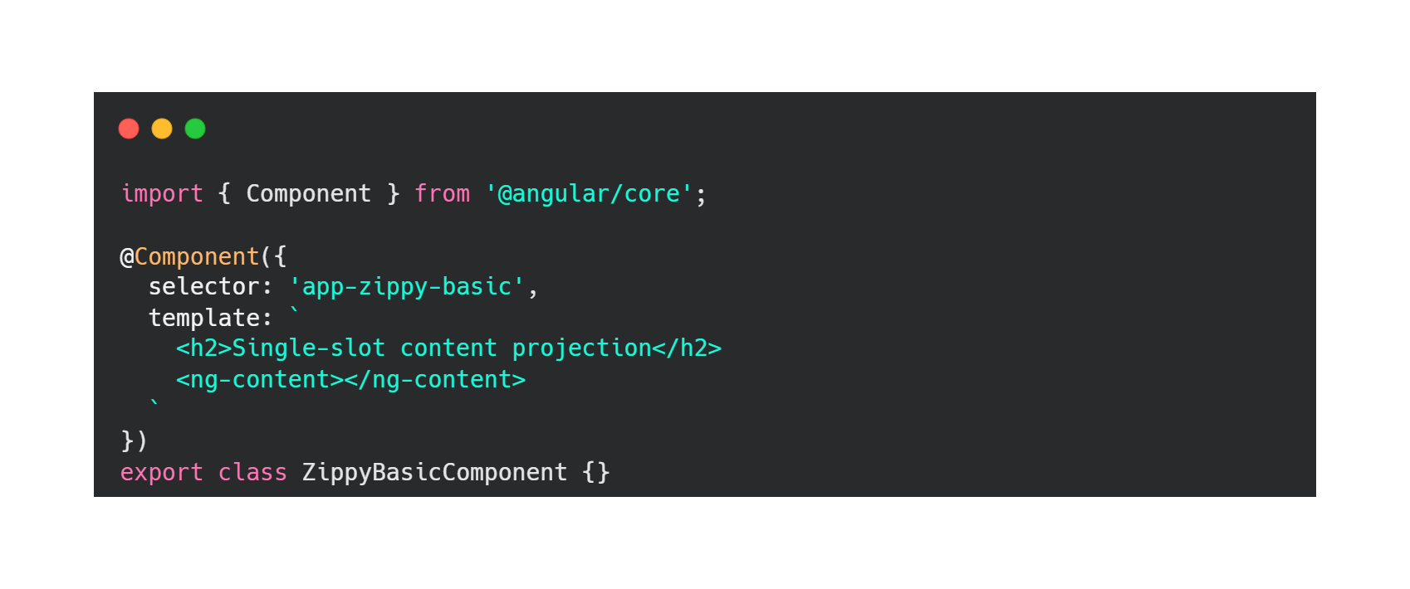
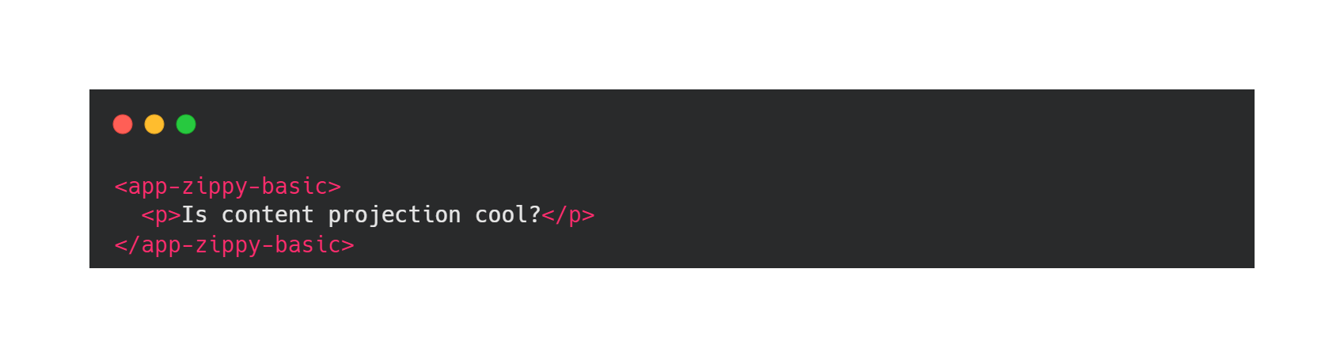
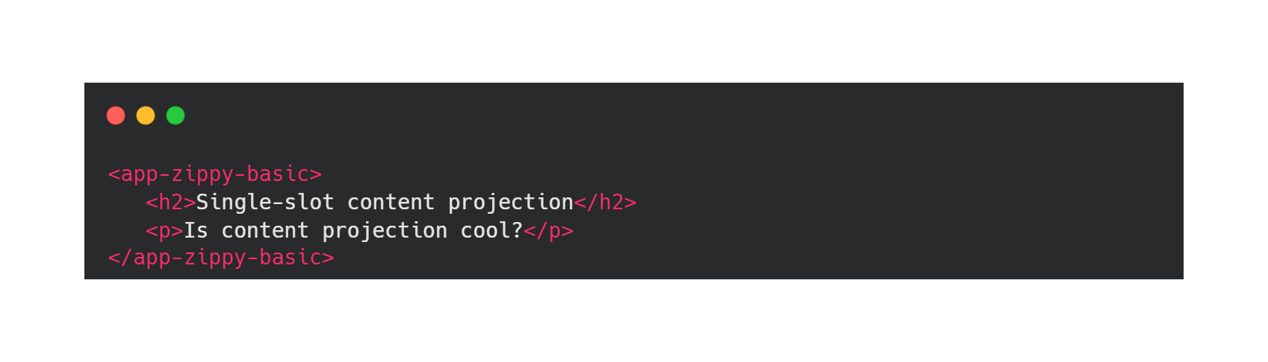

Slide 78
Component hooks
AfterContent hooks concern ContentChildren, the child components that Angular projected into the component.
ngAfterContentInit
is called after the Component’s projected content has been fully initialized
this hook is also raised even is no content to project
external content injected from the parent component via Content Projection
ng-content element: placeholder for the content from the parent
called only during the first detection change
ngAfterContentChecked
respond after Angular checks the content projected into the directive or component
called after ngAfterContentInit() and every subsequent ngDoCheck()

Slide 79
Component hooks
AfterView hooks concern ViewChildren, the child components whose element tags appear within the component's template
ngAfterViewInit
invoked when the component’s view has been fully initialized
called once after the first ngAfterContentChecked()
ngAfterViewChecked
invoked each time the view of the given component has been checked by the change detection mechanism of Angular
called after the first ngAfterViewInit() and every subsequent ngAfterContentChecked()
ngOnDestroy
called immediately before Angular destroys the directive or component
cleanup work

Slide 80

Let’s practice!

Slide 81

Forms

Slide 82
Different approaches
Type | Template | Component class
Template driven approach | Majority of the form responsibility will be managed by template. We write the html statements for our form input elements. Validation and error messages are handled in template. Two-way data binding between template and data model Form model will be generated automatically by Angular | Responsible for managing the properties for data binding. Contains the methods for form operations. Manage the data model for two-way data binding.
Reactive Forms | Contains Form element Contains input elements Data binding between template and FormModel | We define the form model by creating the instance of FormControl and FormGroup. Validation and error messages are managed by component class. Contains the properties and methods for managing the data.

Slide 83
Template driven forms
ngModel directive – create two-way data bindings for reading and writing input-control values
ngModelChange event – emits the value entered by the user
Need to import FormModules

Slide 84
Let’s practice!

Slide 85
Reactive forms
Are built around observable streams;
A simpler way to populate and to send data to the server;
Provide a model-driven approach to handling form inputs whose values change over time;

Slide 86
Adding a basic form control
There are 3 steps to using form controls:
Import the ReactiveFormsModule in your application;
Generate a new FormControl instance and save it in the component;
Register the FormControl in the template.

Slide 87
Grouping form controls
Reactive form provide two ways of grouping multiple related controls into a single form:
FormGroup – defines a form with a fixed set of controls that you manage together;
FormArray – defines a dynamic form, where you can add or remove form controls at run time.

Slide 88
Get data from a form
There are two ways to get the model value:
(ngSubmit) event – can have the values when click on the submit button;
valueChanges observable – can subscribe it to receive the new value.

Slide 89

Let’s practice!

Slide 90


Exercise
Create a new reactive form in “About” component that will contain:
Input for first name
Input for last name
Input for email

Slide 91
Update parts of the data model
There are two ways to update the model value:
setValue() – set a new value for an individual control;
patchValue() – replace any properties in the object that changed in the form model.

Slide 92
Let’s practice!

Slide 93

Validating forms

Slide 94
Validate input with template-drive forms
To add validation to a template-drive form, you add the validation attributes as you would with native HTML form validation;
Inspect the control’s state using the name attribute
Examples:
required
minlength
maxlength

Slide 95
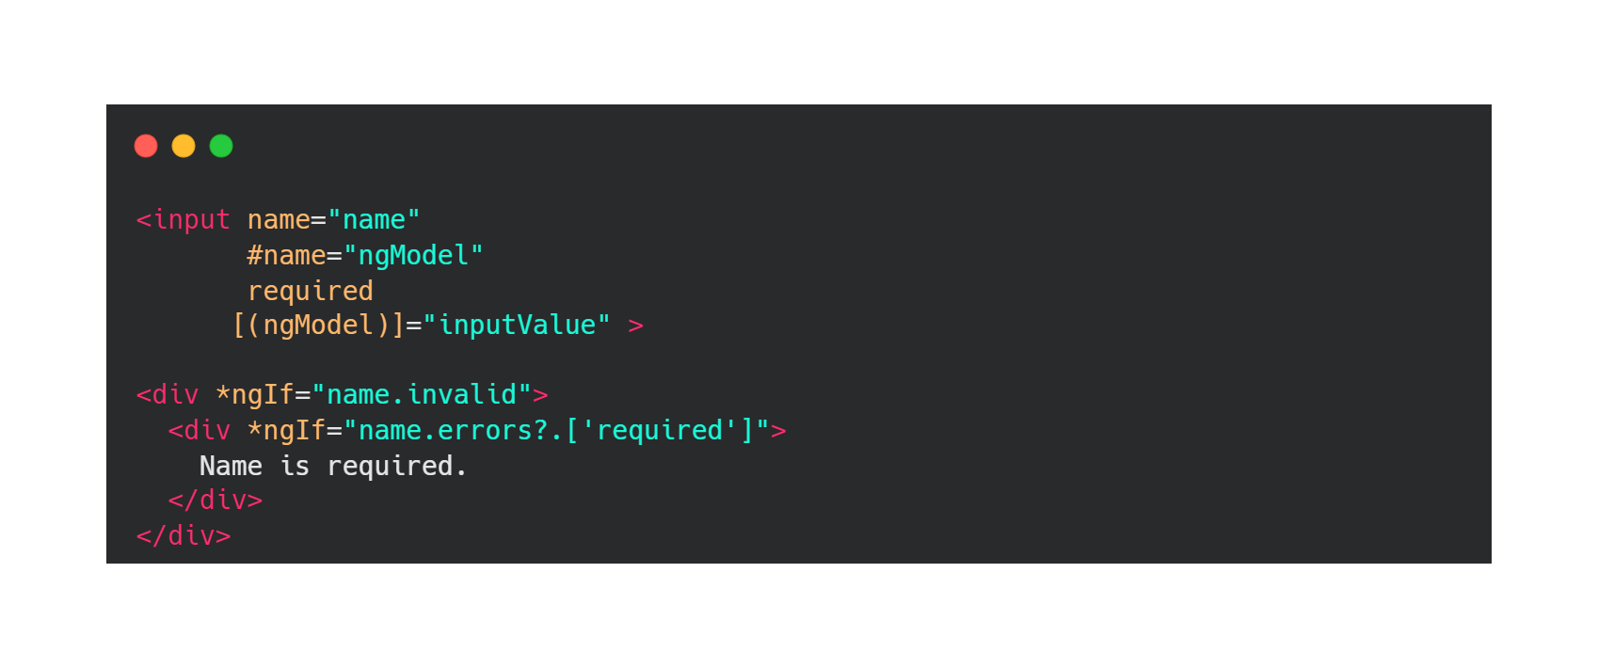
Validate input with template-driven forms

Slide 96
Validate input with reactive forms
Add validator functions directly to the form control model in the component class;
Steps to add form validation:
Import a validator function in your TS file
Add the validator to the field in the form
Add logic to handle the validation status

Slide 97
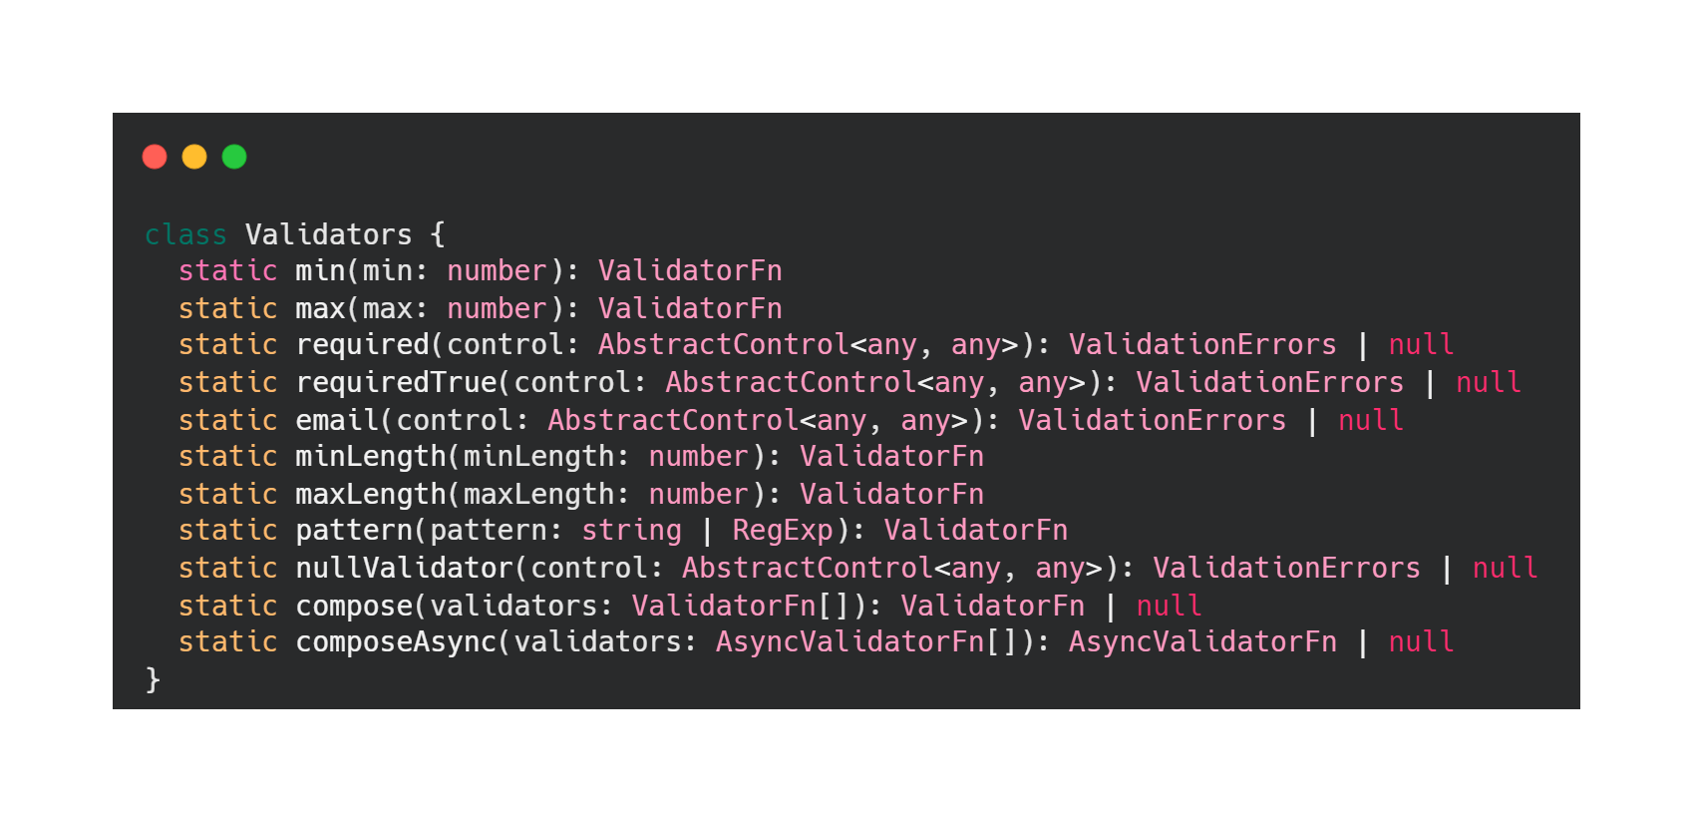
Reactive forms - validators

Slide 98
Form states
pristine – if the user has not yet changed the value in the UI
dirty – if the user has changed the value in the UI
untouched – the user has not yet triggered a blur event on it
touched – a control is marked once the user triggered a blur event on it

Slide 99

Let’s practice!

Slide 100
Exercise
Add a min length validator for password input from Login component and add a suggestive error message.

Slide 101
Recap
Lifecycle hooks
Forms
ngModel directive
Reactive forms
Validation
ngModel directive: HTML attributes
Reactive forms: Validators

Slide 102
Break

Slide 103

Services in Angular
ng generate service service-name
A service is a class with a well-defined purpose.

Slide 104

Dependency Injection
A coding pattern in which a class receives the dependencies/instances of other objects it needs from an external source rather than creating them itself
@Injectable()
services are declared with @Injectable() decorator to mark DI

Slide 105
Root injector vs Component Injector
Root injector | Component injector
Recommended for most scenarios The service is available throughout the application | The service is available only to that component and its child (nested) components Isolates a service used by only one component and its children Provides multiple instances of the service

Slide 106


Slide 107
HTTP Requests
Most front-end applications communicate with backend services over the HTTP protocol
XMLHttpRequest
fetch()
HttpClient

Slide 108
HTTP Client
Ensure the communication with back-end via HTTP protocol.
The advantages of using HTTP client are:
the ability to request typed objects,
error handling,
response and request interception.
Import HttpClientModule in the app module.
Inject where is needed via DI in the service.

Slide 109
RxJs - Reactive Extensions Library for JavaScript
RxJS is a library for reactive programming using Observables, to make it easier to compose asynchronous or callback-based code.
Reactive programming is a declarative programming paradigm concerned with data streams and the propagation of change.

Slide 110
Observables
Provides a stream of data ( 0 or more values of any type)
Pushed over any amount of time (can end, but not necessarily)
Cancelable ( can be stopped from emitting a value - unsubscribed)
Lazy - won't emit values until we subscribe to them

Slide 111


Observables

Slide 112
Anatomy of an Observable
Creating Observables
Subscribing to Observables
Executing the Observable
Disposing Observables

Slide 113

Creating Observables
Using the constructor
Using creation functions
of(value1, value2, value3)
from(promise/itterable/observable)
fromEvent(target, eventName)
interval(time)
timer(time)

Slide 114

Subscribing to Observables
Subscribing to an Observable is like calling a function, providing callbacks where the data will be delivered to

Slide 115


Executing Observables
There are three types of values an Observable Execution can deliver:
Next notification: sends a value such as a Number, a String, an Object, etc.
Error notification: sends a JavaScript Error or exception.
Complete notification: does not send a value.

Slide 116

Disposing Observable Executions

Slide 117

Observers
A consumer of values delivered by an Observable
Objects with three callbacks, one for each type of notification that an Observable may deliver

Slide 118

Subscription
An object that represents a disposable resource, usually the execution of an Observable
A Subscription essentially just has an unsubscribe() function to release resources or cancel Observable executions

Slide 119

Subject
like an Observable, but can multicast to many Observers
like EventEmitters: they maintain a registry of many listeners

Slide 120


Subject
Every Subject is an Observable
Every Subject is an Observer

Slide 121
Operators
map([🐄, 🥔, 🌽, 🐔], cook) => [🍔, 🍟, 🍿, 🍗] filter([🍔, 🍟, 🍿, 🍗], isVegetarian) => [🍟, 🍿] reduce([🍟, 🍿], eat) => [💩]

Slide 122
Using models
The models are used to define what type of objects we use in the communication with the back-end services.

Slide 123

Angular Material

Slide 124
About Angular Material
User Interface (UI) component library that developers can use in their Angular projects to speed up the development
Steps:
Install Angular Material: https://material.angular.io/guide/getting-started
Go to: https://material.angular.io/components/categories
Choose a component that is useful for you
Find her module that needs to be imported into your application
Use the component where you need
Done 🔆

Slide 125
Useful links
https://developer.mozilla.org/en-US/docs/Web/HTTP/Methods
https://rxjs.dev/
https://angular.io/guide/reactive-forms
https://angular.io/guide/forms-overview
https://medium.com/codingthesmartway-com-blog/using-bootstrap-with-angular-c83c3cee3f4a
https://angular.io/docs
https://codecraft.tv/courses/angular/dependency-injection-and-providers/ngmodule-providers-vs-component-providers-vs-component-viewproviders/

Slide 126

Q&A

Slide 127

Feedback

Slide 128


Slide 129

Thank you!

